Slide 1
4.7 Inheritance
ITP3914 – Programming
Part 4 – Programming with Objects and Classes

Slide 2
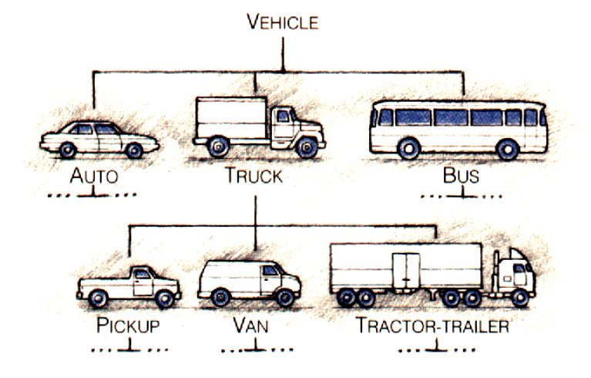
Class Hierarchy
All vehicles have:
License number
Seating capacity
Model
Speed
And are able to:
Accelerate
Decelerate
Turn steering

Slide 3
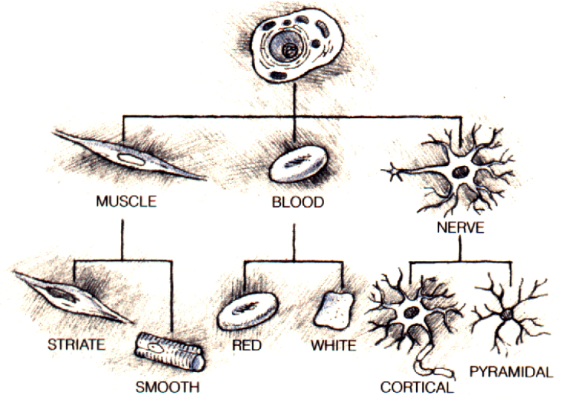
Class Hierarchy
All animal cells have:
Nucleus
DNA
And are able to:
Respire
Die

Slide 4
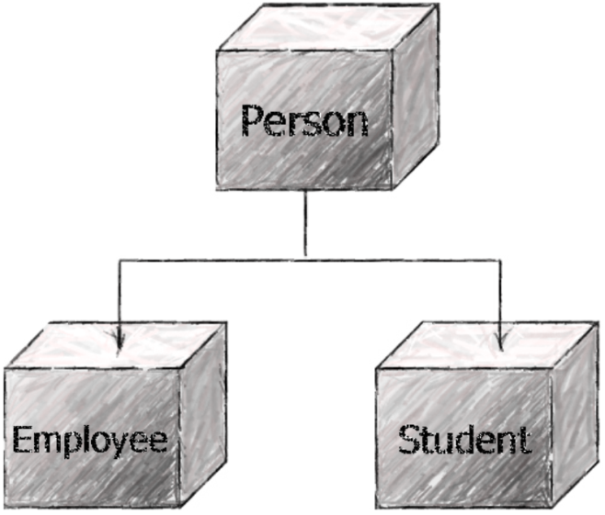
Class Hierarchy
All person have:
Name
Gender
Date of Birth
And are able to:
Eat
Sleep

Slide 5
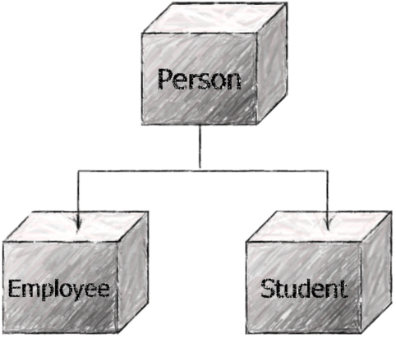

Class Hierarchy
Virtually, everything can be classified under a class hierarchy.

Slide 6
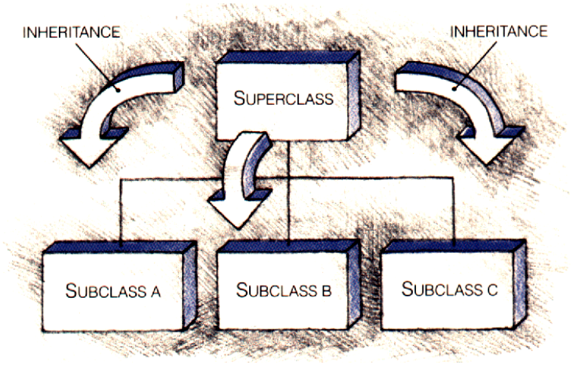

Inheritance
Inheritance is a mechanism whereby one class of objects (subclass) can be defined as a special case of a more general class (superclass), thus automatically including the methods and variables of the superclass.
All person have Name, Gender, Date of Birth, and are able to Eat and Sleep.
Employee and Student being the subclasses also have those variables and methods.

Slide 7
More on Inheritance
Name
Gender
Date of Birth
Name
Gender
Date of Birth
Name
Gender
Date of Birth
Name
Gender
Date of Birth
Name
Gender
Date of Birth
Eat
Sleep
Eat
Sleep
Eat
Sleep
Eat
Sleep
Eat
Sleep
Employee id
Department
Salary
Student id
Course
Variables and methods specific to the subclass.
Variables and methods specific to the subclass.
doHomework()
attendLesson()
seatEam()
workOnProject()
workOverTime()
reportToBoss()

Slide 8

Access Specifiers Revisited

Slide 9
public Members
public members
A superclass's public members are accessible anywhere inside the program when there is a reference to that superclass.
public members defined in a subclass’s superclass are also accessible anywhere inside the program when there is a reference to that subclass.
superclass Vehicle
public String license;
public int speed;
public static void main(…)
{
Vehicle v = new Vehicle();
Bus b = new Bus();
v.speed = 0;
b.speed = 0;
}
subclass Bus
public String route;
public int capacity;

Slide 10
public Members
private members
private members defined in a superclass are accessible only to those methods defined in that superclass.
Even a subclass cannot access those private members defined in its superclass.
superclass Father
private float money;
money += 100;
subclass Kid
This statement is incorrect.
money = money - 100;

Slide 11
public Members
protected members
A superclass's protected access members serve as an intermediate level of protection between public and private access.
A superclass's protected members may be accessed only by methods of the superclass and by methods of subclasses.
superclass Father
protected float money;
public static void main(…)
{
Father f = new Father();
f.money = 0;
}
money += 100;
This statement is incorrect.
subclass Kid
This statement is correct.
money = money - 100;

Slide 12

Example 1
This example illustrates:
Basic syntax in Java inheritance
The use of protected variables
How constructors of superclass and subclass are related.

Slide 13
public class Point {
protected int x, y; // coordinates of the Point
public Point() {
System.out.println("Constructor: Point()");
setPoint( 0, 0 );
}
public Point( int a, int b ) {
System.out.println("Constructor: Point(int a, int b)");
setPoint( a, b );
}
public void setPoint( int a, int b ) {
x = a;
y = b;
}
public int getX() { return x; }
public int getY() { return y; }
public String toString() {
return "[" + x + ", " + y + "]";
}
}

Slide 14
public class Circle extends Point { // inherits from Point
private double radius;
public Circle() {
// implicit call to superclass constructor
System.out.println("Constructor: Circle()");
setRadius( 0 );
}
public Circle( double r, int a, int b ) {
super( a, b ); // call to superclass constructor
System.out.println("Constructor: Circle(double r, int a, int b) ");
setRadius( r );
}
public void setRadius( double r ) {
radius = ( r >= 0.0 ? r : 0.0 );
}
public double getRadius() { return radius; }
public double area() { return Math.PI * radius * radius; }
public String toString() {
return "Center = " + "[" + x + ", " + y + "]" +
"; Radius = " + radius;
}
}
“extends Point” specifies that Circle is a subclass of Point.
Directly access the protected instance variables x and y that were inherited from Point.
The toString() method overrides the one in the superclass.

Slide 15
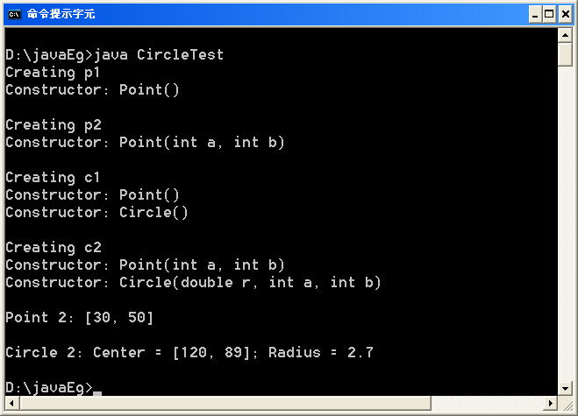
public class CircleTest {
public static void main( String [] args )
{
Point p1, p2;
Circle c1, c2;
System.out.println("Creating p1");
p1 = new Point();
System.out.println("\nCreating p2");
p2 = new Point( 30, 50 );
System.out.println("\nCreating c1");
c1 = new Circle();
System.out.println("\nCreating c2");
c2 = new Circle( 2.7, 120, 89 );
System.out.println("\nPoint 2: " + p2);
System.out.println("\nCircle 2: " + c2);
}
}
Point’s constructor is also executed.

Slide 16
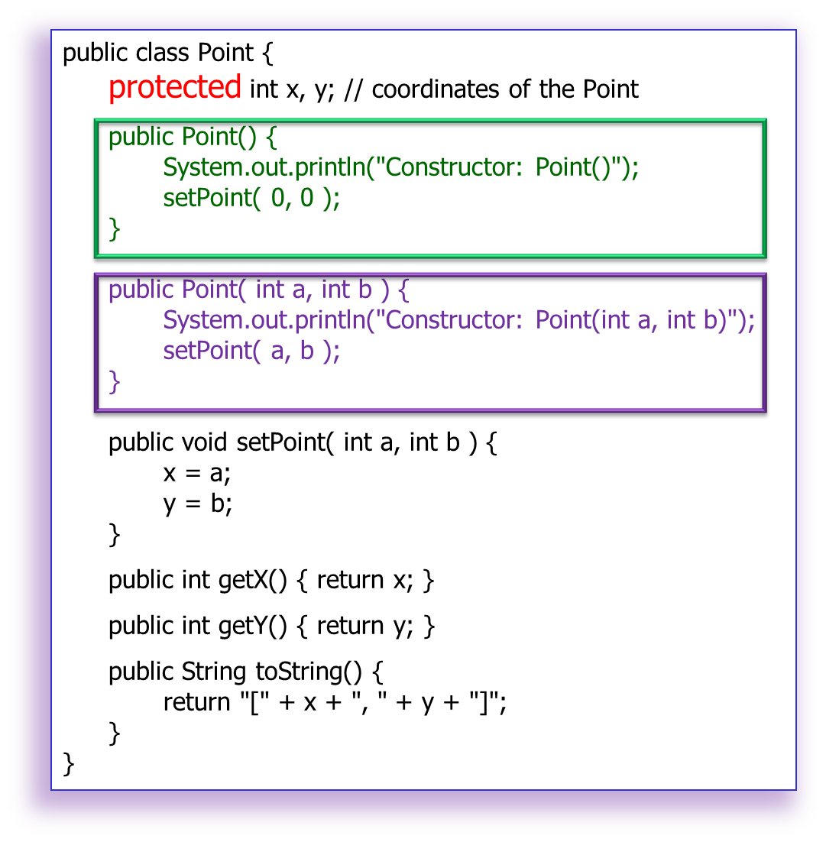
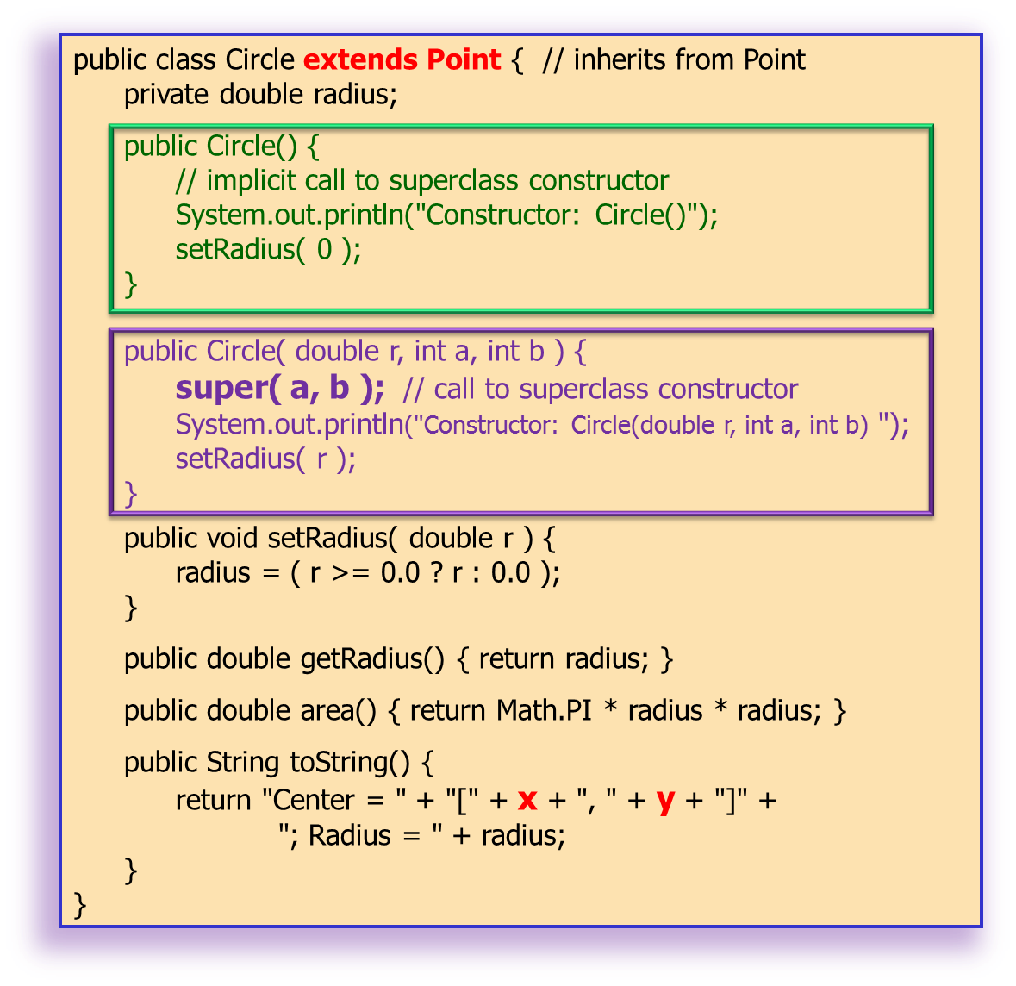
We now focus on the Circle objects instantiation.
Creating c1
Constructor: Point()
Constructor: Circle()
Creating c2
Constructor: Point(int a, int b)
Constructor: Circle(double r, int a, int b)
❷
❸
❷
public class CircleTest {
public static void main( String [] args )
{
Point p1, p2;
Circle c1, c2;
System.out.println("Creating p1");
p1 = new Point();
System.out.println("\nCreating p2");
p2 = new Point( 30, 50 );
System.out.println("\nCreating c1");
c1 = new Circle();
System.out.println("\nCreating c2");
c2 = new Circle( 2.7, 120, 89 );
System.out.println("\nPoint 2: " + p2);
System.out.println("\nCircle 2: " + c2);
}
}
❶
❸
❶

Slide 17
Summary
public class Point {
…
public Point()
{
System.out.println("Constructor: Point()");
setPoint( 0, 0 );
}
…
}
Java automatically and implicitly calls the superclass’s constructor when the subclass object is being instantiated. Of course, the no-arg constructor is called.
public class Circle extends Point {
…
public Circle()
{
// implicit call to superclass constructor System.out.println("Constructor: Circle()");
setRadius( 0 );
}
…
}

Slide 18
Summary again
Every subclass is required to call it’s direct superclass’s constructor, either implicitly or explicitly, as its first task in the constructor.
public class Point {
…
public Point( int a, int b )
{
System.out.println("Constructor: Point(int a, int b)");
setPoint( a, b );
}
…
}
You may choose to call the superclass’ s constructor explicitly with super(), especially when a constructor with parameters is desired.
public class Circle extends Point { // inherits from Point
…
public Circle( double r, int a, int b )
{
super( a, b ); // call to superclass constructor
System.out.println("Constructor: Circle(double r, int a, int b) “ );
setRadius( r );
}
…
}

Slide 19
Example 2
This example illustrates:
A 3-level class hierarchy
protected methods
Access overridden methods defined in a superclass.

Slide 20
public class Point {
protected int x, y; // coordinates of the Point
public Point() {
System.out.println("Point's constructor");
setPoint( 0, 0 );
}
public Point( int a, int b ) {
System.out.println("Point's constructor");
setPoint( a, b );
}
protected void setPoint( int a, int b ) {
x = a;
y = b;
}
protected int getX() { return x; }
protected int getY() { return y; }
public String toString() {
return "[" + x + ", " + y + "]";
}
}
Point
public class Circle extends Point {
protected double radius;
public Circle() {
System.out.println("Circle's constructor");
setRadius( 0 );
}
public Circle( double r, int a, int b ) {
super( a, b ); // call the superclass constructor
System.out.println("Circle's constructor");
setRadius( r );
}
protected void setRadius( double r ) {
radius = ( r >= 0.0 ? r : 0.0 );
}
protected double getRadius() { return radius; }
protected double area() {
return Math.PI * radius * radius;
}
public String toString() {
return "Center = " + super.toString() +
"; Radius = " + radius;
}
}
Circle
A new method added to the subclass.
Call to superclass’s toString() method.

Slide 21
public class Cylinder extends Circle {
protected double height; // height of Cylinder
public Cylinder() {
System.out.println("Cylinder's constructor");
setHeight( 0 );
}
public Cylinder( double h, double r, int a, int b ) {
super( r, a, b );
System.out.println("Cylinder's constructor");
setHeight( h );
}
public void setHeight( double h ) { height = ( h >= 0 ? h : 0 ); }
public double getHeight() { return height; }
public double area() {
return 2 * super.area() +
2 * Math.PI * radius * height;
}
public double volume() {
return super.area() * height;
}
public String toString()
{
return super.toString() + "; Height = " + height;
}
}
Point
Circle
Cylinder

Slide 22
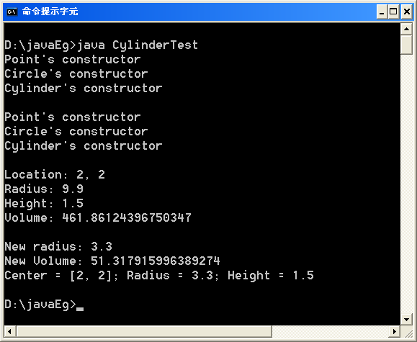
Constructors of all superclasses are called. Note carefully the sequence with which the constructors are called.
getX() getY() from Point
getRadius() from Circle
getHeight() from Cylinder
public class CylinderTest {
public static void main( String [] args )
{
Cylinder c0 = new Cylinder();
System.out.println();
Cylinder c = new Cylinder(1.5, 9.9, 2, 2);
System.out.println();
System.out.println("Location: "+c.getX()+", "+c.getY());
System.out.println("Radius: " + c.getRadius());
System.out.println("Height: " + c.getHeight());
System.out.println("Volume: " + c.volume());
c.setRadius(3.3);
System.out.println("\nNew radius: " + c.getRadius());
System.out.println("New Volume: " + c.volume());
System.out.println("" + c);
}
}
Cylinder’s toString() calls Circle’s toString(), which in turn calls Point’s toString().

Slide 23
Example 3
This example illustrates:
Using the this reference.
The method finalizer().

Slide 24
public class Point {
protected int x, y; // coordinates of the Point
public Point() {
x = 0;
y = 0;
System.out.println( "Point constructor: " + this );
}
public Point( int a, int b ) {
x = a;
y = b;
System.out.println( "Point constructor: " + this );
}
protected void finalize() {
System.out.println( "Point finalizer" );
}
public String toString() {
return "[" + x + ", " + y + "]";
}
}
public class Circle extends Point { // inherits from Point
protected double radius;
public Circle() {
// implicit call to superclass constructor here
radius = 0;
System.out.println( "Circle constructor: " + this );
}
public Circle( double r, int a, int b ) {
super( a, b ); // call the superclass constructor
radius = r;
System.out.println( "Circle constructor: " + this );
}
protected void finalize() {
System.out.println( "Circle finalizer" );
super.finalize(); // call superclass finalize method
}
public String toString() {
return "Center = " + super.toString() +
"; Radius = " + radius;
}
}

Slide 25
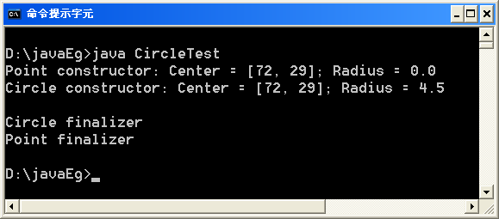
public class CircleTest {
public static void main( String [] args)
{
Circle circle1;
circle1 = new Circle( 4.5, 72, 29 );
System.out.println();
circle1 = null; // mark for garbage collection
System.gc(); // call the garbage collector
}
}
The Point constructor calls the toString() method of Circle!
Note the order with which the constructor and finalizer are called.

Slide 26
Remark on Constructors
When an object of a subclass is instantiated, the superclass's constructor should be called to do any necessary initialization of the superclass instance variables inherited to the subclass object.
An explicit call to the superclass constructor (via super) can be provided as the first statement in the subclass constructor.
Otherwise, the subclass constructor will call the superclass default constructor (with no argument) implicitly.

Slide 27
Remark on Finalizer
When If the subclasses in your class hierarchy define finalize methods, the subclass finalize method should invoke the superclass finalize method as its last action.
Method finalize should always be defined as protected so subclasses have access to the method but other classes do not.

Slide 28

END.

